Slide 1


Hotels One View

Slide 2

Presented by:
Track Supervisors:
Project Supervisors:
Sara Ashraf
Mostafa Mamdouh
Ahmed Shaaban
Esraa Ahmed
Eng. Rana Salah
Eng. Ahmed Abuelkheir
Eng. Mostafa Madkor
Eng. Soaad Elsaid

Slide 3

Table of Contents
01
02
03
04
Introduction
Problem Statement
Objectives
Solution Architecture
Data Sources
Data Model
Data Integration Jobs
Visualization
KPIs
Dashboard Demo
Conclusion
Future Work

Slide 4
Introduction

Slide 5
Introduction
Every industry, including travel and hospitality, needs data analytics to understand customer behavior and drive improvements to their operations.

Slide 6
Problem Statement
Over the years, it becomes harder to make well informed, long-term and strategic decisions quickly and efficiently.This is where hotel business intelligence comes in. It gives you relevant and deep insights into how your business is performing today.

Slide 7
Objectives
Improve decision making.
Perform predictive analysis by comparing different metrics across any timeline.
Determine what to do to increase profit or avoid losses in the future.
Improve marketing and revenue management strategy.

Slide 8
2. Solution Architecture

Slide 9
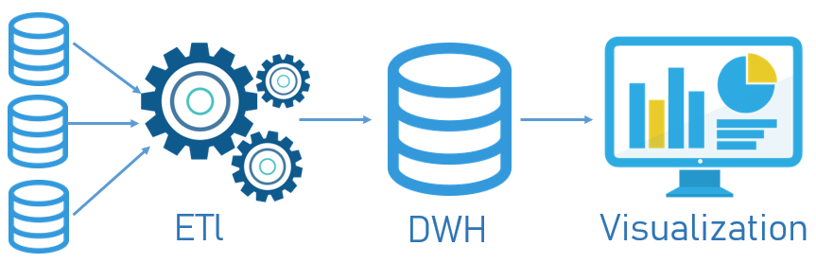
General BI Architecture

Slide 10
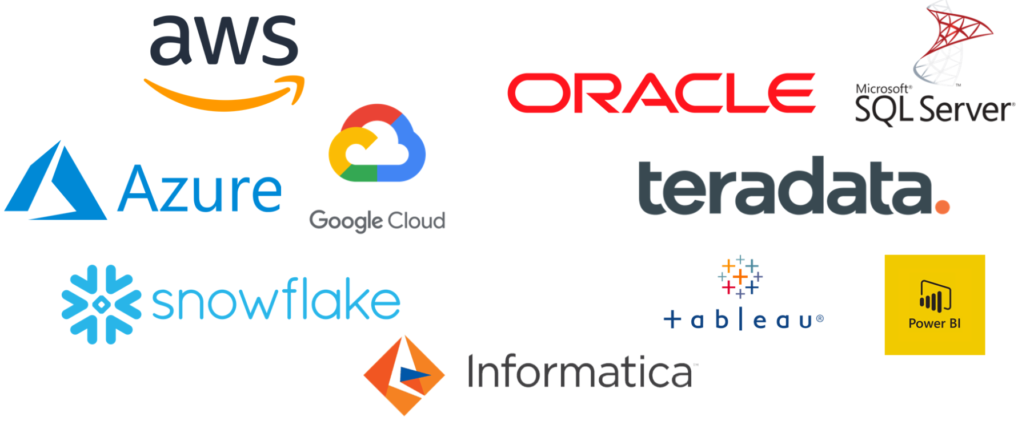
Available BI Architecture

Slide 11
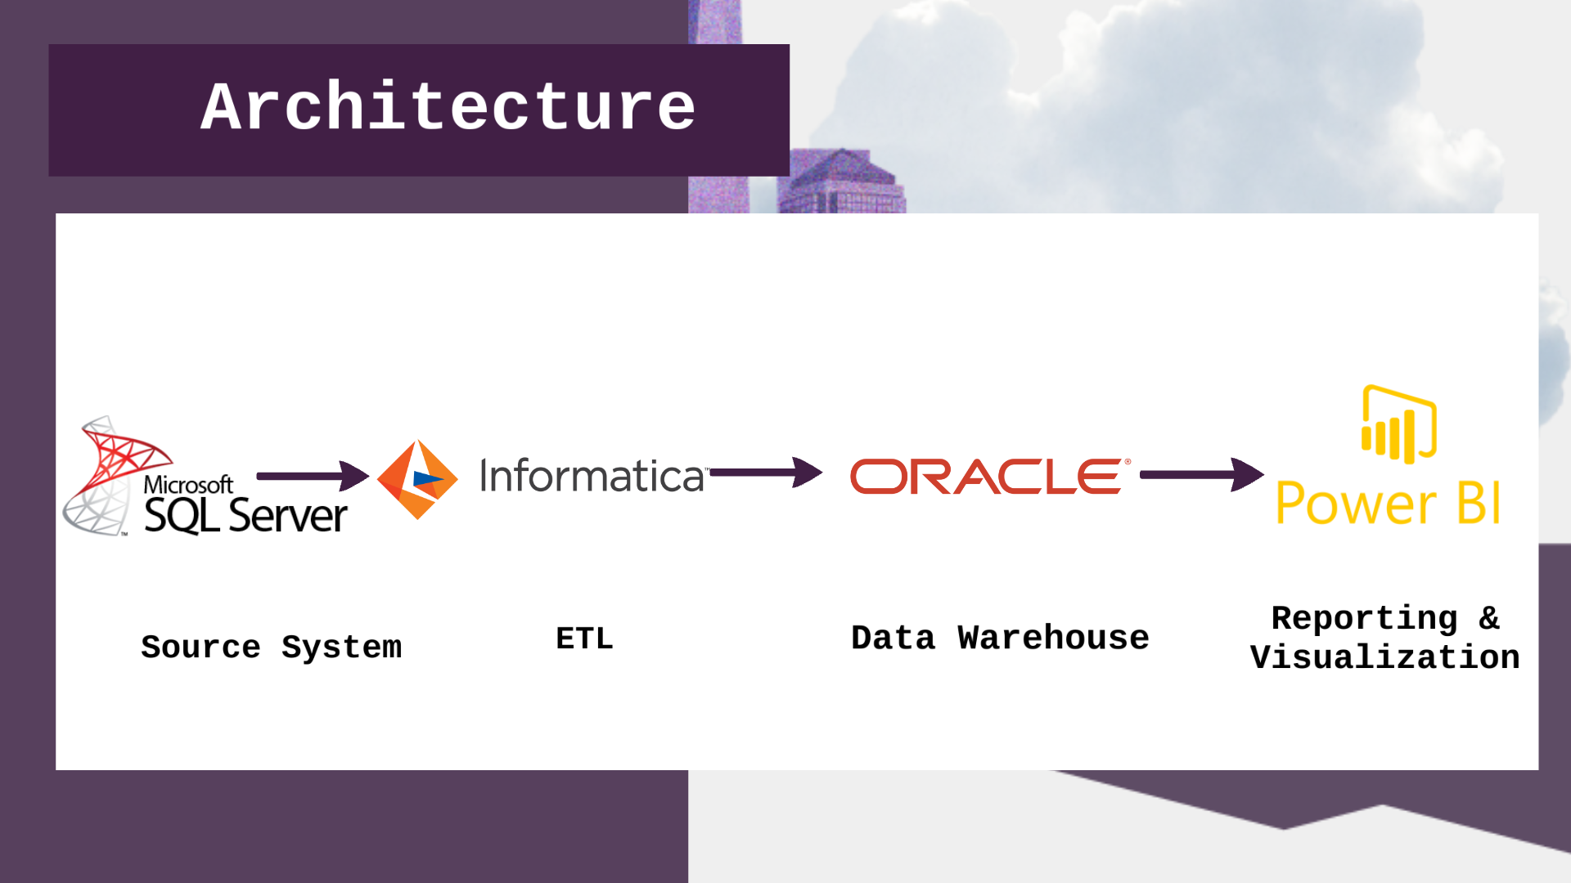
Our Solution Architecture
Neptune
Mercury
Jupiter
Neptune is the farthest planet from the Sun
Mercury is the smallest planet in the Solar System
Jupiter is the biggest planet in the Solar System

Slide 12
3. Source Exploration

Slide 13
Source System
Licenses
License_Master
License_Status
License_Type
License_StarRating
City
Country
TaxItems
Revenue_App
Monthly_Residence
Daily_Occupancy

Slide 14
4. Data Model

Slide 15
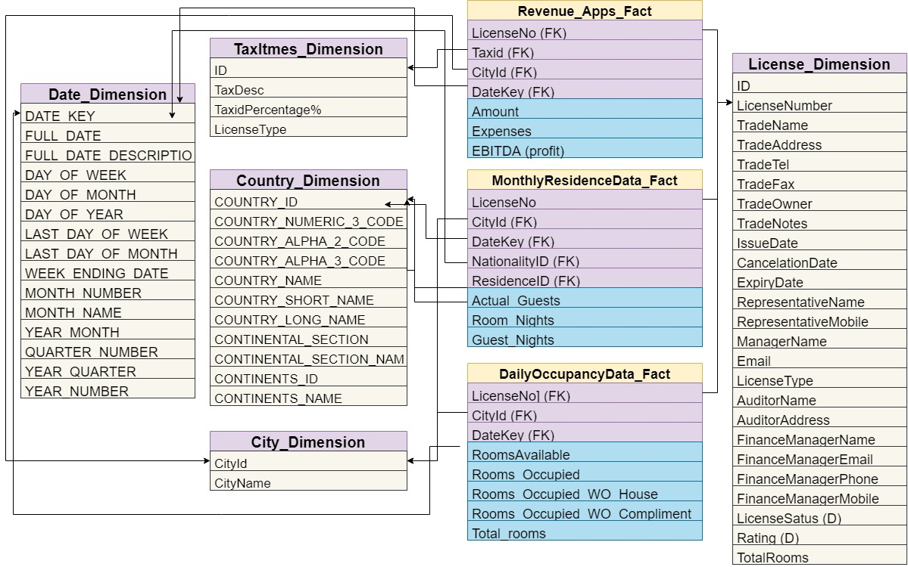

Slide 16
5. Data Integration

Slide 17
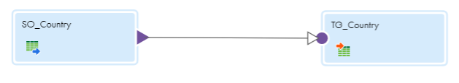
Country Dim Mapping
Take only the desired columns

Slide 18
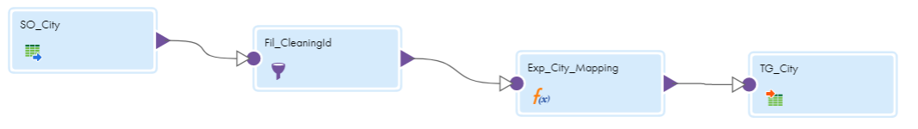
City Dim Mapping
FIlter unwanted rows
Mapping CityId to match with fact tables

Slide 19
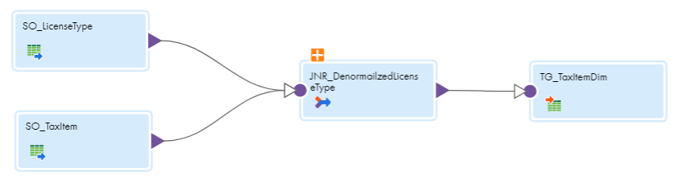
TaxItem Dim Mapping
Denormalize LicenseType

Slide 20
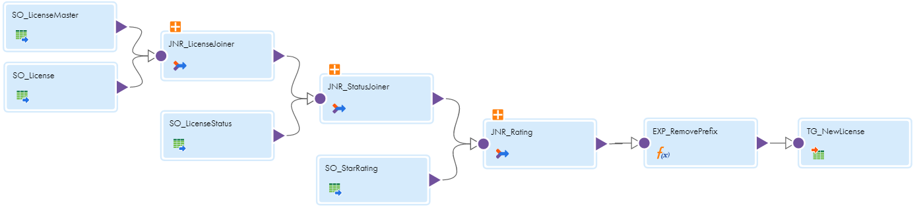
License Dim Mapping
Merge both License Tables
Denormalize LicenseStatus and StarRating
Transform LicenseNumber Column

Slide 21
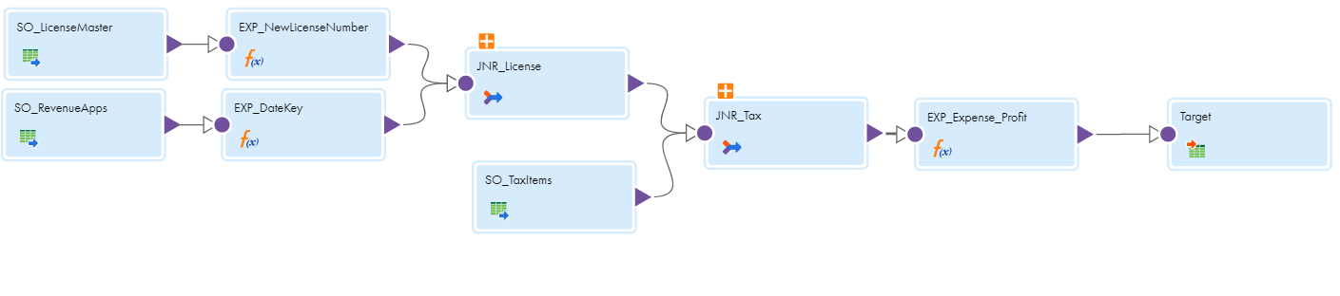
Revenue Apps Fact Mapping
Join with LicenseMaster to include CityId column
Transform DateKey column
Join with TaxItem to include Tax Percentage
Calculate net profit and expense

Slide 22
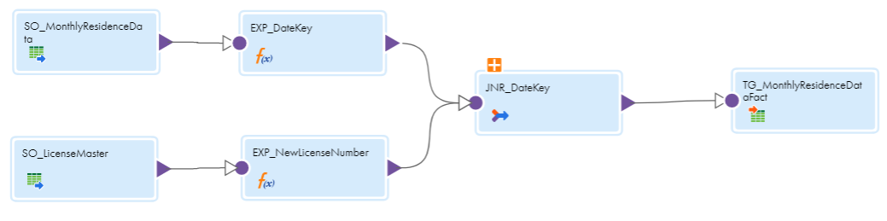
Monthly Residence Fact Mapping
Join with LicenseMaster to include CityId column
Transform DateKey column

Slide 23
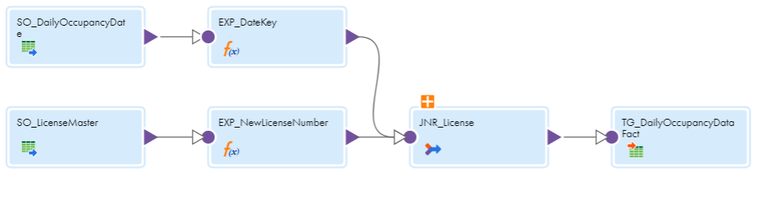
Daily Occupancy Fact Mapping
Join with LicenseMaster to include CityId column
Transform DateKey column

Slide 24
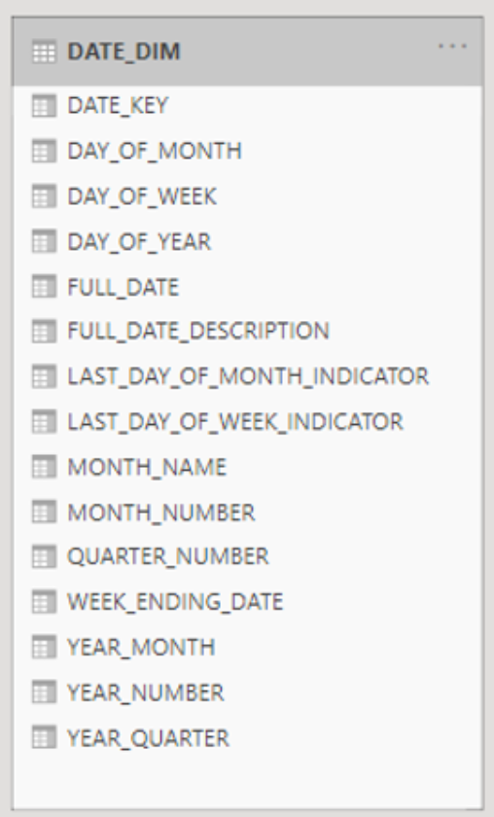
Date Dim
PLSQL Script Generation for the Date Dimension in the Target

Slide 25
6. KPIs

Slide 26
Project KPIs
1- Profit
Profit per city
Profit per license type
Profit per year.
2- Occupancy rate
Top 10 hotels per occupancy rate.
Occupancy rate by year per city.
3- Nationality.
Guests night per nationality.
4- Rating
Rating vs. Gained profit.

Slide 27
7. Visualization

Slide 28
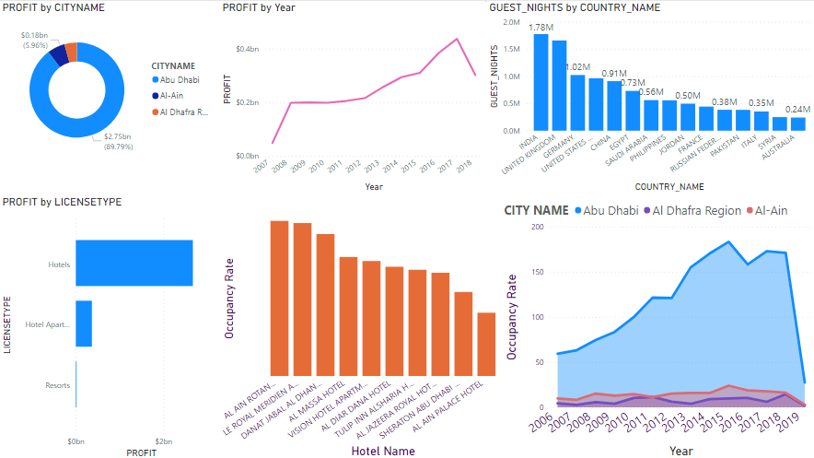
Dashboard
$20K
45K

Slide 29
Dashboard
Demo

Slide 30
Future Work
Replication
Synchronization

Slide 31
Any Questions?

Slide 32
Thanks!

